Slide 1

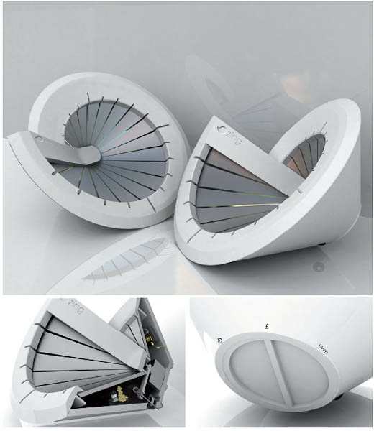
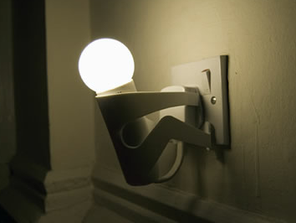

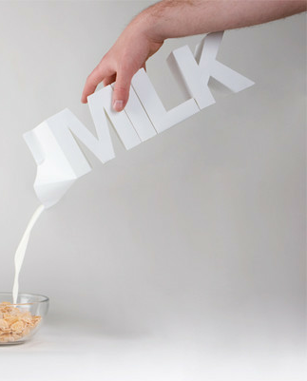

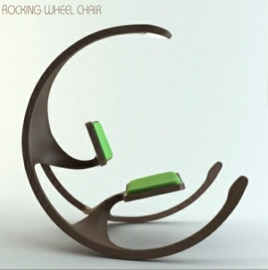
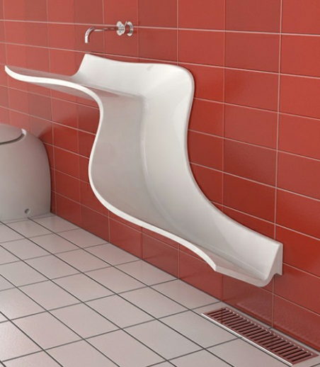

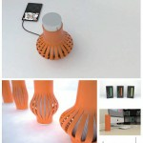
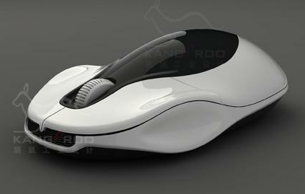
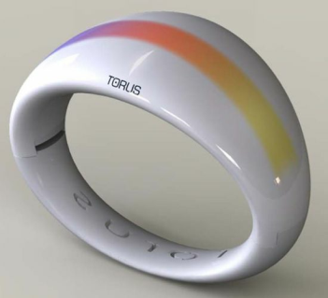
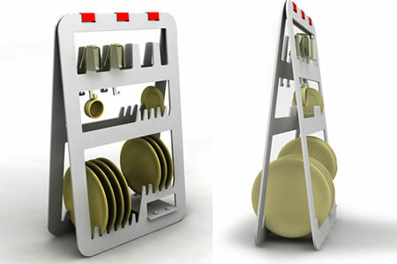
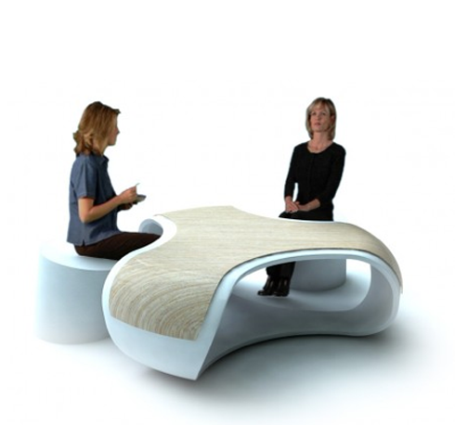
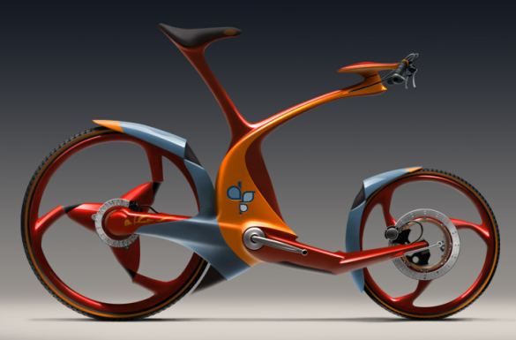
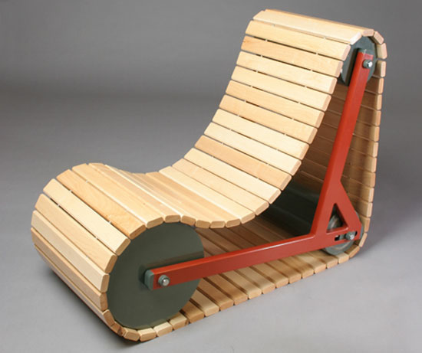
DESIGN
iGCSE Design Technology - Assessment Overview
Notes:
Demonstration of pewter casting
- Features of moulds & potential issues
- Demonstration of hand made mould to
pewter casting
- Student create practice mould using hand
tools and cast.

Slide 2
IGCSE Design Technology
Aims
The aims are to enable students to:
• Develop creative thinking in areas relevant to design and technology
• Apply problem-solving skills to practical and technological problems
• Develop the communication skills central to design, realisation and evaluation
• Gain knowledge and understanding of design and technology
• Develop skills in research and investigation
• Design and make products, taking into consideration sustainability and the
wider impact on society
• Develop the ability to make aesthetic, economic, ethical and technical value
judgements.
DESIGN

Slide 3
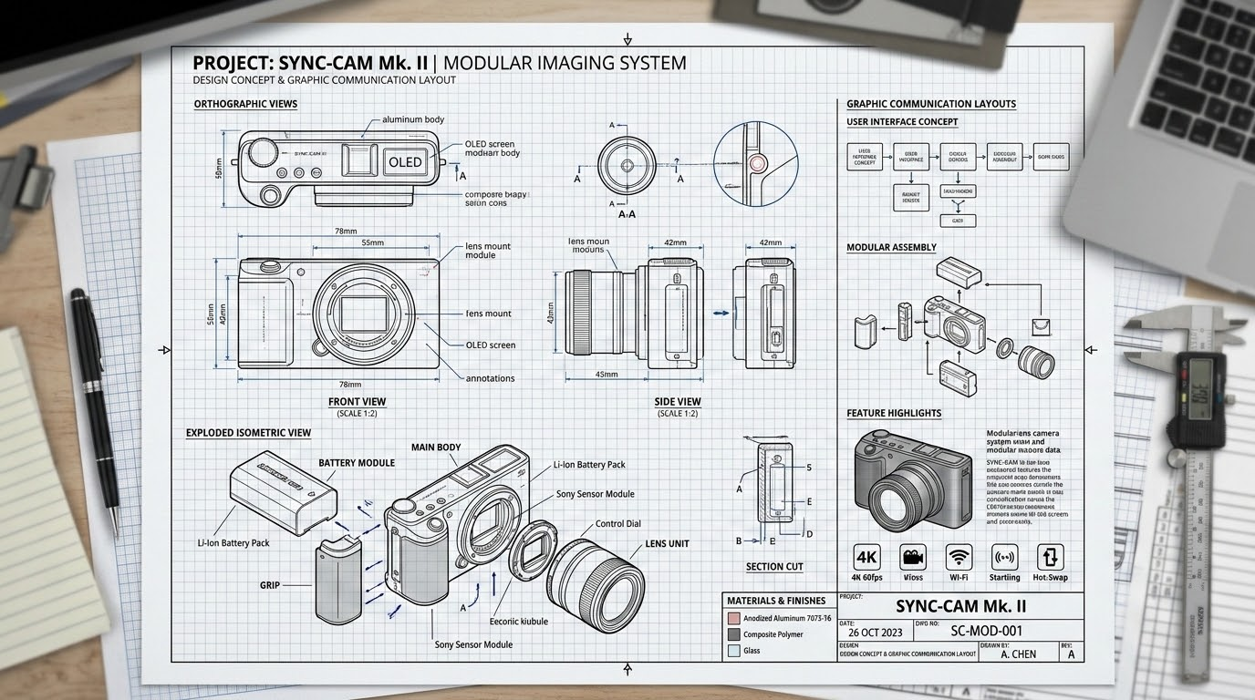
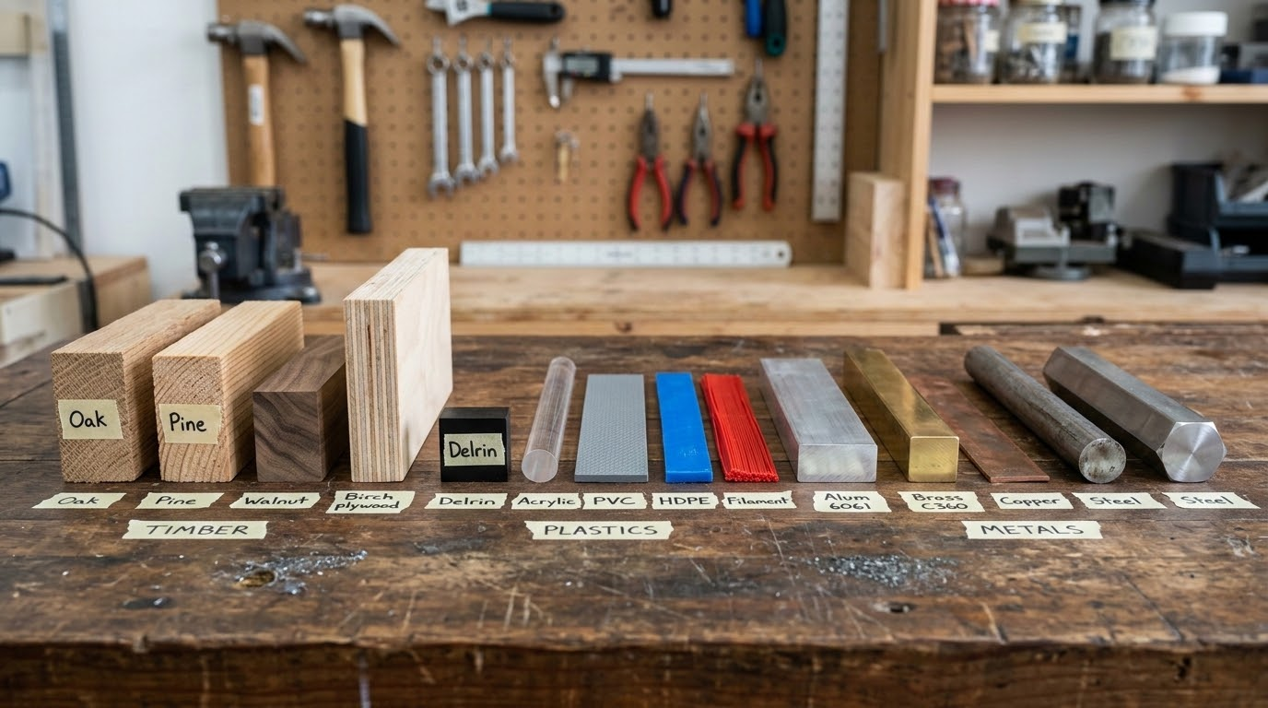
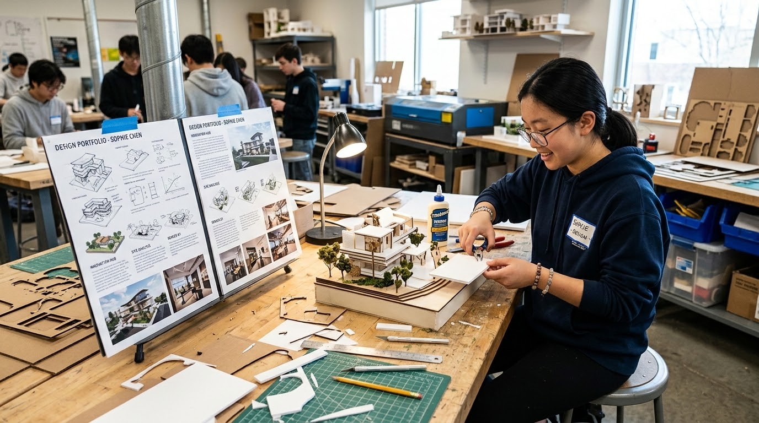
IGCSE Design Technology
Assessment Components
2026-28
DESIGN
Design Knowledge (25%)
Materials & Process (25%)
Coursework Project (50%)
50 Marks - Written Paper
Focuses on designing principles and common knowledge around creative graphic communication.
Externally Assessed
50 Marks - Written Paper
Tests specialist knowledge of materials, industrial manufacturing, and fabrication processes.
Externally Assessed
100 Marks - Design Portfolio
Personal project involving research, development, and crafting a complete physical prototype.
School-based & Moderated Externally

Slide 4
IGCSE Design Technology
Assessment
Candidates will be eligible for grades A* to G.
DESIGN
Design Knowledge Exam | Material & Process Exam | Coursework Project
25% - 50 Marks | 25% - 50 Marks | 50% - 100 Marks
Written paper based on designing and common knowledge around design and graphic communication Externally Assessed | Written paper based on specialist content of materials, processes and manufacturing methods Externally Assessed | Personal Design Project following the design process creating a portfolio and prototype School-based assessment. Internally assessed and externally moderated.

Slide 5
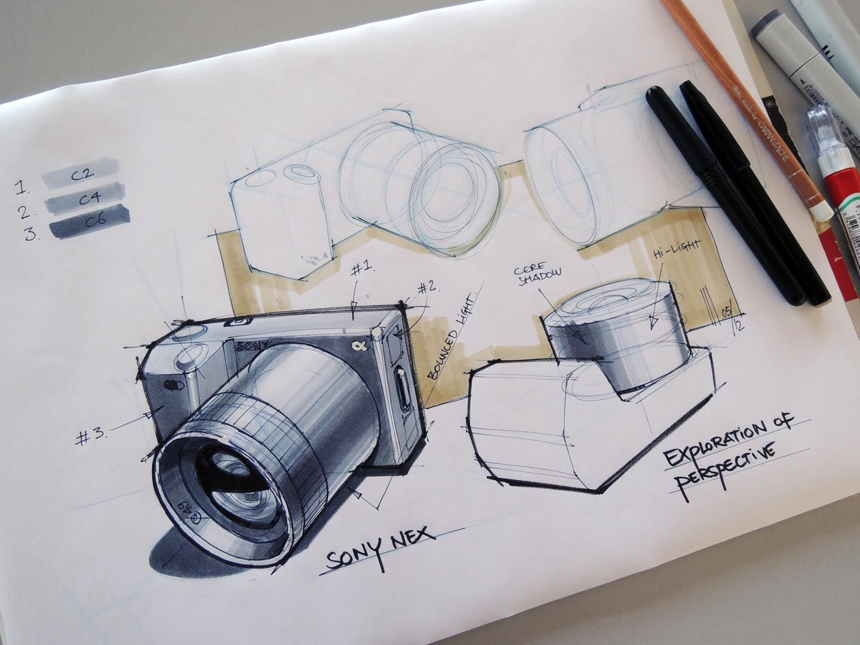
IGCSE Design Technology
Content
Core Knowledge - Paper 1
Influences on Design
Design principles
Communicating Designs
Making Principles
Material Classification
Structures
Mechanisms
Electronics
DESIGN

Slide 6
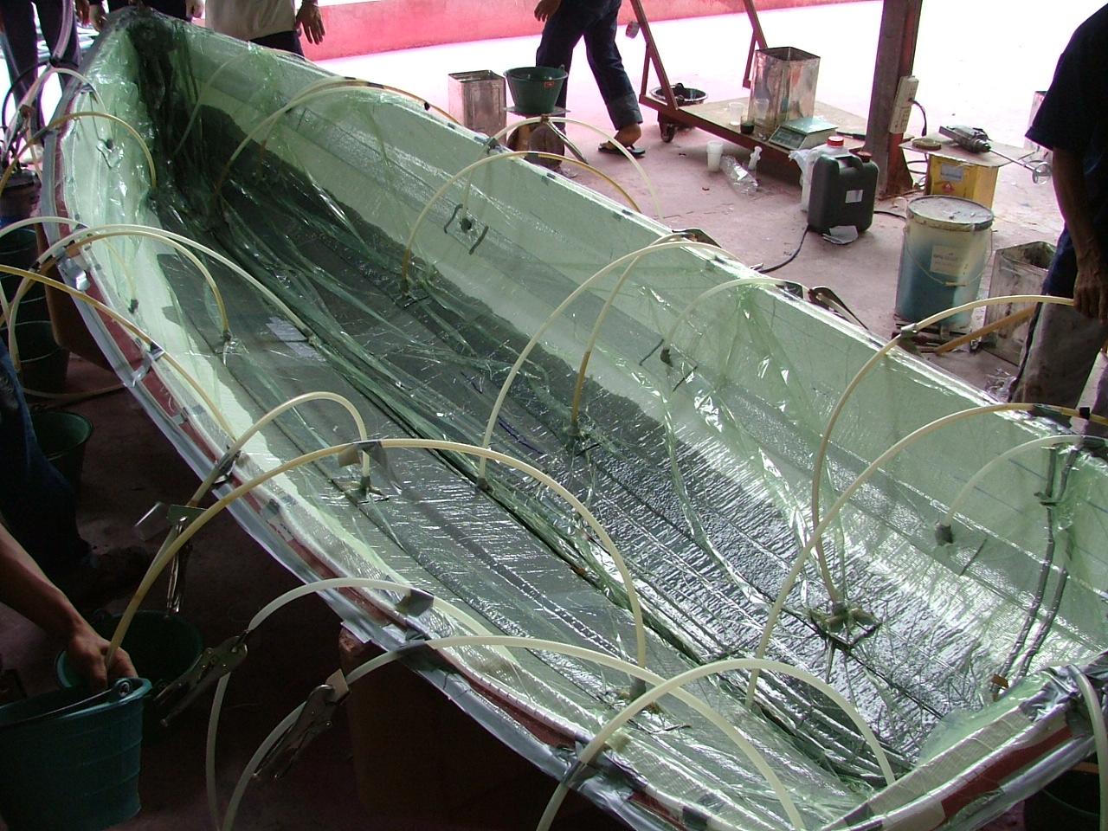
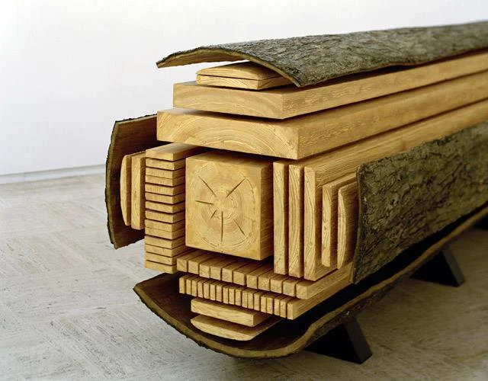
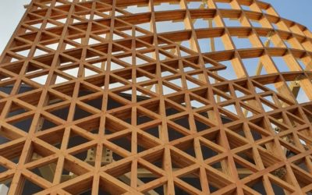
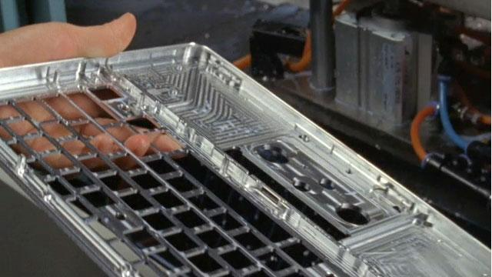
IGCSE Design Technology
Content
Specialist content - Paper 2
Types of material
Manufacturing Processes
Commercial Manufacturing Methods
Product Analysis
Use of Technology
DESIGN

Slide 7
IGCSE Design Technology
IB Design Technology - Group 4
Standard Level
Ergonomics and user centered design
Design for sustainability and circular economy
Prototyping and modelling
Materials, properties and selection
Inclusive design and responsibilities of the designer
Design Process
Higher Level Extension
Beyond usability
Structural, Mechanical & Electronic Systems
Manufacturing techniques
Production systems
Design for manufacture
DESIGN
IGCSE to IB Progression
The IGCSE Design Technology content directly links with
IB DT Content, giving you an advantage on your understanding.

Slide 8

IGCSE Design Technology
Career Opportunities
Product Designer
Engineer
Architect
Interior designer
Graphic designer
Ergonomist
Electronics engineer
Material Engineer
Design teacher
Manufacturing Engineer
Structural Engineer
Furniture designer
Health and safety
Illustrator
Mechanical engineer
Systems developer
Civil Engineer
DESIGN
Building Character traits and thinking that can be used in other subjects and desired at universities and careers.

Slide 9
IGCSE Design Technology
Independence & Support
DESIGN
Independence
Take ownership of your creative journey and manage your project time effectively.
Independently work around lessons to stay on track.
Do your own stuff—explore personal design interests.
Experiment, be creative, and think differently.
Work ahead independently using the provided guides.
✦Support
Leverage the design studio resources and expert teacher guidance available to you.
Use the DT Labs and take advantage of GCSE freetime.
Talk to your teacher regularly to ask for guidance.
Proactively ask for constructive feedback on your designs.

Slide 10
IGCSE Design Technology
Resources
- Guides and examples
- Resources and videos
- Updated knowledge from exam questions
- Coursework guides
- Assessment
DESIGN
bit.ly/islanddt
- Create a shortcut on your Computer.

Slide 11


IGCSE Design Technology
Classroom/workshop rules
DESIGN

